Slide 1
React & Redux
Keep your head cool and focused, there’s a tons of stuff to see today
Cedric Hartland

Slide 2
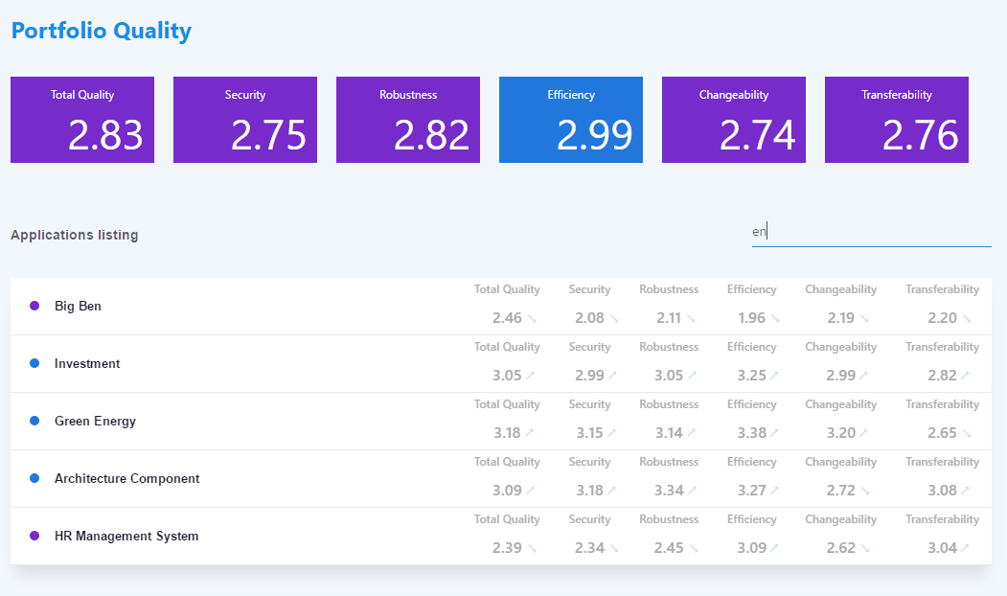
A project we’re targeting

Slide 3
React – a gentle introduction
Javascript library for building user interfaces

Slide 4
React – a library that defines views through components
In a declarative way
Components (objects…) means reusability
Given an application state, renders some shadow DOM application state are inputs named properties
Business logic, state flow and DOM rendering are independent
Optimized rendering engine inspired from game engines
Little assumption on application structure can “easily” integrate with other technologies
Can render on server side SEO please
What else ? Not so much

Slide 5
React – what’s actually good in it ?
Components
Enhanced reusability well, keep it generic if you plan on reusing…
Rendering lifecycle with optimizations
Basic type checking not so basic with propTypes
Becomes powerful with ES6 and more it’s not react, it’s ES6
Dependency management
Uptaded syntax and language features
Css inclusions
Arguably JSX
As opposed to string based templates

Slide 6
React – JSX
Update to JS – ease the code readability for React
Elements, expressions, functions, etc.
CSS horror !! Js based CSS injection, prefer CSS imports/modular CSS
ES5
JSX
React.createElement(
"div",
{ "class": "app-head" },
React.createElement("h1", null, "Portfolio Quality" ),
React.createElement(
Tiles,
{ color: "blue" },
React.createElement(Tile, { value: 2.8294564, title: "Total quality" }),
React.createElement(Tile, { value: 2.75189, title: "Security" }),
React.createElement(Tile, { value: 2.82154, title: "Robustness" }),
React.createElement(Tile, { value: 2.98678, title: "Efficiency" }),
React.createElement(Tile, { value: 2.74234, title: "Changeability" }),
React.createElement(Tile, { value: 2.76354, title: "Transferability" })
)
);
<div class="app-head" >
<h1>Portfolio Quality</h1>
<Tiles color="blue" >
<Tile value={2.8294564} title="Total quality" />
<Tile value={2.75189} title="Security" />
<Tile value={2.82154} title="Robustness" />
<Tile value={2.98678} title="Efficiency" />
<Tile value={2.74234} title="Changeability" />
<Tile value={2.76354} title="Transferability" />
</Tiles>
</div>

Slide 7

A (not so) simple component
class Tile extends React.Component {
static propTypes = {
value: React.PropTypes.number,
title: React.PropTypes.string
};
render() {
return ( <div className="tile">
<div className="tile-header">{this.props.title}</div>
<div className="tile-value">{numeral(this.props.value).format('0.00')}</div>
</div>
);
}
}
Reusable class or function
Js Expressions in brackets
Properties types
Optional parenthesis wrapping
JSX declarations

Slide 8
Using this component
<div className="tiles">
<Tile value={2.8294564} title="Total quality" />
<Tile value={2.75189} title="Security" />
…
</div>
Properties
passed explicitely
to the component
Reuse component as an html element
From collection of data to collection of components
<div className="tiles">
{data.map((sample, index) => {
return <Tile key={index} {...sample} />;
})}
</div>
Properties are submitted implicitely from object
Key is required for collections
So React can omptimize re-rendering

Slide 9

Adding user interactions
class Filter extends React.Component {
…
render() {
return (
<div className="filter-input">
<input
type="text"
value={this.props.filterText}
placeholder={this.props.placeholder}
onChange={this.props.handleFilter}
/>
</div>);
}
}
Bind functions to events
Beware, binding to this use ES6 !

Slide 10
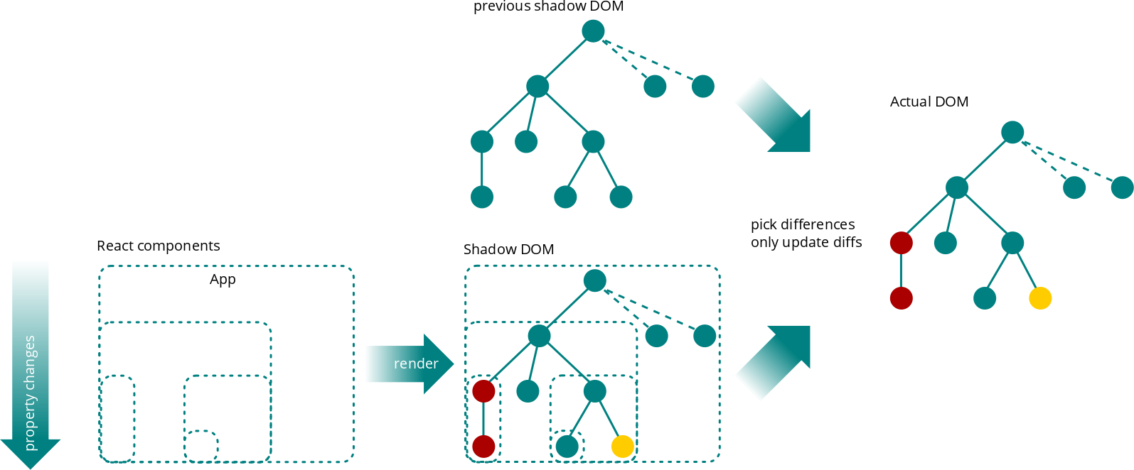
(re-)Rendering workflow

Slide 11
A few words on performance
Mounting (first render) is not cheap estimated x 5 times slower to jquery
Creation of shadow DOM
Rendering of shadow DOM elements to actual DOM
Updating state
Component properties (input) changes trigger re-rendering
Creation of shadow DOM
Rendering of only differences to actual DOM strong positive impact on performance
Creating and comparing shadow DOMs still not actually cheap
Optimize via shouldComponentUpdate
Bring business logic and guess whether the component should call render at all to reduce impact of creating and comparing shadow DOMs

Slide 12
React
A few words before moving to next topic…
…just in case it was not that clear
React is designed in a declarative way
It can define it’s own internal state, but…
...most components will always return same content for given input and not hold internal state dumb components, pure components
No more jquery, backbone or whatever rendering tweaks on user interactions or from other sources
A single DOM source of truth is the output of render function
Application state is not held in component ! Well, it could but to be considered with care

Slide 13
React – dumb & smart components
Application state is not held in component
Most components are said to be dumb
only display data
Dispatch events from user actions
Some smarter components
Operate other components and user actions functions
Some bind data-source to operated dumb components

Slide 14
Redux, a sweet introduction
Single source of truth, read-only state, pure functions

Slide 15
Redux – what the flux ?
React takes data and produce DOM
Need for a data-source-management workflow
Single source of truth
Flux, the original worflow
Dispatcher
Action
Store
React views

Slide 16
Redux – what the flux ?
React takes data and produce DOM
Need for a data-source-management workflow
Single source of truth
Flux, the worflow more in details
Dispatcher
Actions
Callbacks
Web API
Web API Utils
Action creators
Store
User Interactions
React views
Change events / Store queries

Slide 17
Redux – flux
Redux proposes an alternative worflow emphasing on the data store
Store is defined through a state
Store updates goes through reducer functions
Reducers consume actions operations that could update state
Reducers define state mutations as pure functions
Why pure functions ?
No need for deep object comparison save on most expensive operation
(state, action) => state

Slide 18
Redux – workflow
Action
Dispatcher
View
Store

Slide 19
Redux – workflow
Action
Dispatcher
Store
Reducers
R
R
View
R
State

Slide 20
Redux – workflow
Dispatcher
API
Action
middlewares
Logs
Delay actions
Store
Loop actions
Reducers
Crash report
R
R
R
…
View
State

Slide 21
Redux – workflow
Dispatcher
API
Action
middlewares
Logs
Delay actions
Store
Loop actions
event
Reducers
Crash report
R
R
R
…
View
State

Slide 22
Redux – workflow
action
Dispatcher
API
Action
middlewares
Logs
Delay actions
Store
Loop actions
Reducers
Crash report
R
R
R
…
View
State

Slide 23
Redux – workflow
action
API
Dispatcher
Action
middlewares
Logs
action
Delay actions
Store
Loop actions
Reducers
Crash report
state
R
R
R
…
View
State

Slide 24
Redux – workflow
Dispatcher
API
Action
middlewares
Logs
Delay actions
Store
Loop actions
Reducers
Crash report
R
R
R
…
View
State
new state

Slide 25
Redux – workflow
Dispatcher
API
Action
middlewares
data
Logs
Delay actions
Store
Loop actions
Reducers
Crash report
R
R
R
…
View
State

Slide 26
Redux – workflow
Dispatcher
API
Action
middlewares
Logs
action
Delay actions
Store
Loop actions
Reducers
Crash report
state
R
R
R
…
View
State

Slide 27
Redux – workflow
Dispatcher
API
Action
middlewares
Logs
Delay actions
Store
Loop actions
Reducers
Crash report
R
R
R
…
View
State
new state

Slide 28
React & Redux
Rock & Roll

Slide 29
Wait, there’s more
Build, enhanced development process and how to test

